Slide 1

6th Grade Math
Unit 4, Lesson 8 Absolute Value – Part 1 Volume 1, pg. 174

Slide 2


Benchmark
MA.6.NSO.1.3
Given a mathematical or real-world context, interpret the absolute value of a number as the distance from zero on a number line. Find the absolute value of rational numbers.
volume 1, pg. 174

Slide 3
Integrated Mathematical Thinking and Reasoning Standards
MA.K12.MTR.4.1 Engage in discussions that reflect on the mathematical thinking of self and others.
MA.K12.MTR.5.1 Use patterns and structure to help understand and connect mathematical concepts.
volume 1, pg. 174

Slide 4

Learning Target
I can find the absolute value of a rational number.
volume 1, pg. 174

Slide 5

Warm-Up
volume 1, pg. 174

Slide 6
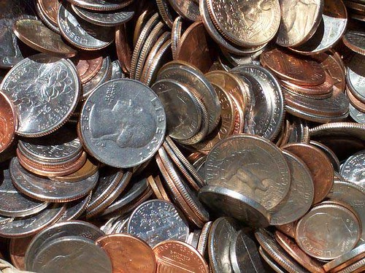
4.8.1 Warm-Up: Would You Rather?
Would you rather have Pile A or Pile B? Justify your reasoning.
Pile A | Pile B
14 pennies | 2 pennies
7 nickels | 4 nickels
2 dimes | 2 dimes
1 quarter | 2 quarters
volume 1, pg. 174

Slide 7

Exploration
volume 1, pg. 175

Slide 8



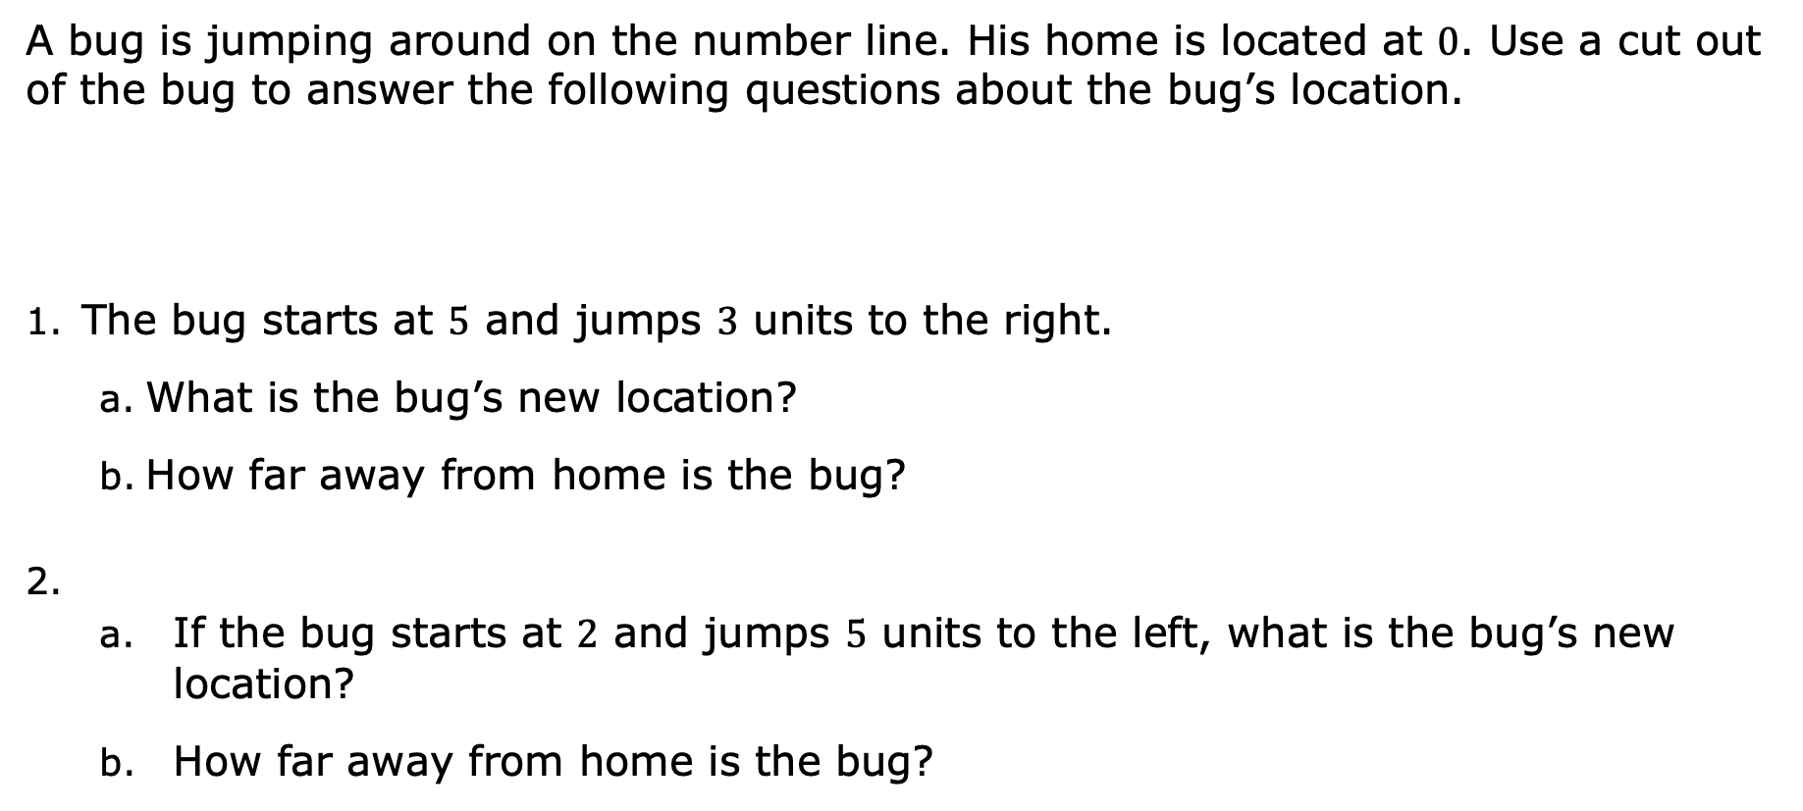
4.8.2 Exploration: Jumping Bugs
A bug is jumping around on the number line. His home is located at $0$. Use a cut out of the bug to answer the following questions about the bug’s location.
The bug starts at $5$ and jumps $3$ units to the right.
What is the bug’s new location?
How far away from home is the bug?
If the bug starts at $2$ and jumps $5$ units to the left, what is the bug’s new location?
How far away from home is the bug?
volume 1, pg. 175

Slide 9
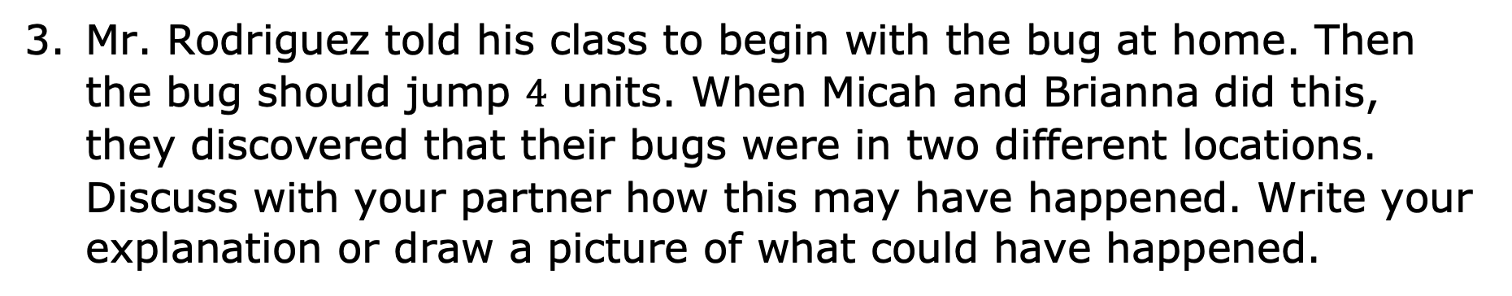
Mr. Rodriguez told his class to begin with the bug at home. Then the bug should jump $4$ units. When Micah and Brianna did this, they discovered that their bugs were in two different locations. Discuss with your partner how this may have happened. Write your explanation or draw a picture of what could have happened.
volume 1, pg. 175

Slide 10

Guided Instruction
volume 1, pg. 176

Slide 11


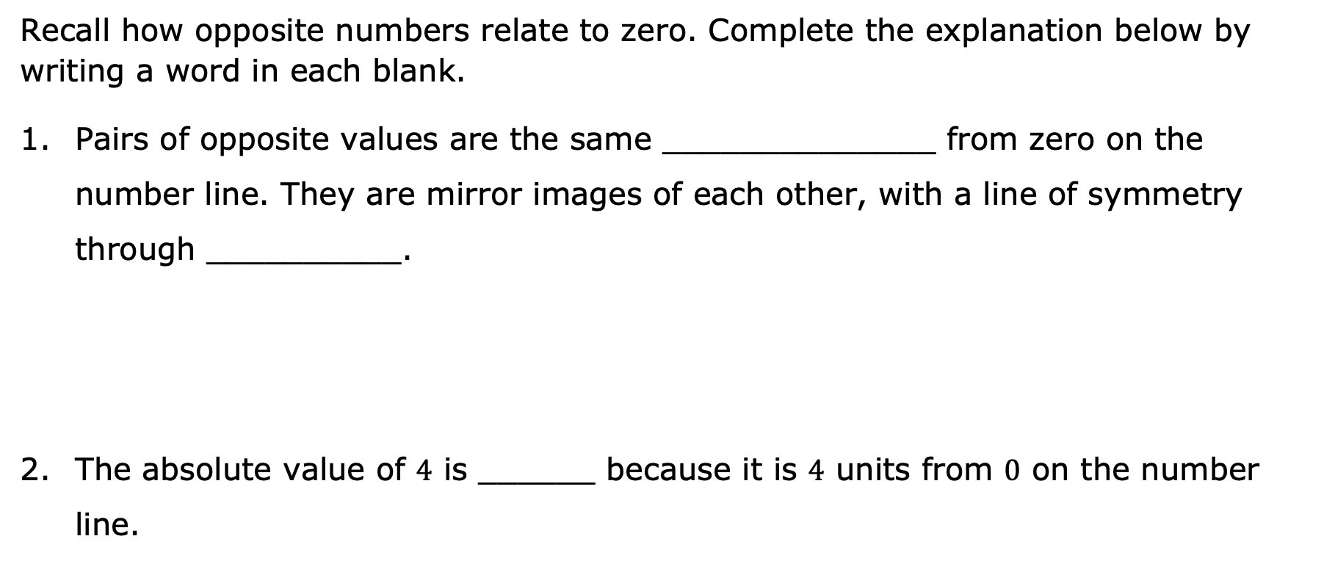

4.8.3 Guided Instruction: Absolute Value and Zero
Recall how opposite numbers relate to zero. Complete the explanation below by writing a word in each blank.
Pairs of opposite values are the same ______________ from zero on the number line. They are mirror images of each other, with a line of symmetry through __________.
The absolute value of $4$ is ______ because it is $4$ units from $0$ on the number line.
Absolute value is the distance a number is from zero ($0$) on a number line.
$$4$$
volume 1, pg. 176

Slide 12

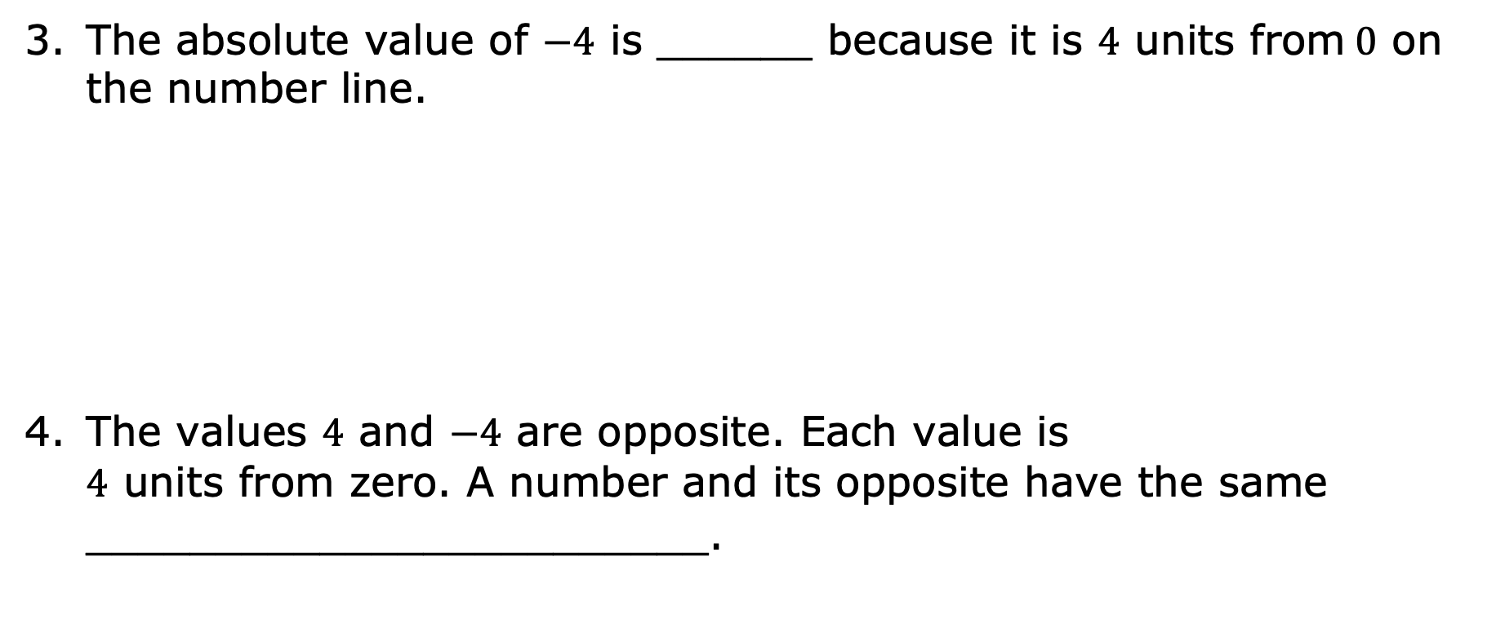
The absolute value of $−4$ is ______ because it is $4$ units from$0$ on the number line.
The values $4$ and $−4$ are opposite. Each value is $4$ units from zero. A number and its opposite have the same ________________________.
$$4$$
volume 1, pg. 176

Slide 13

Guided Practice
volume 1, pg. 176

Slide 14

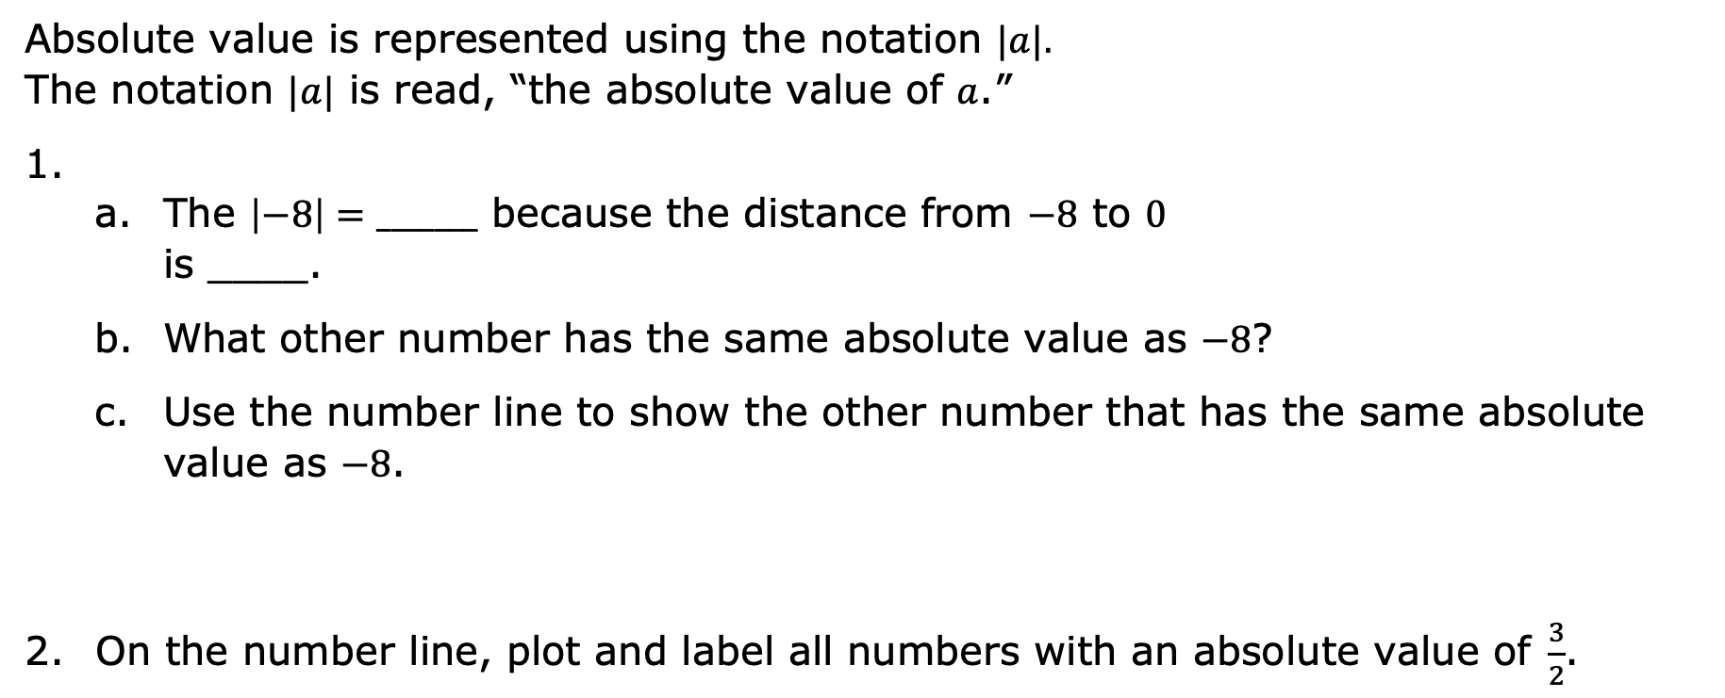
4.8.4 Guided Practice: Absolute Value and Zero
Absolute value is represented using the notation $|a|.$ The notation $|a|$ is read, “the absolute value of $a$.”
The $\left|−8\right|=_______$ because the distance from $−8$ to $0$ is ____.
What other number has the same absolute value as $−8$?
Use the number line to show the other number that has the same absolute value as $−8$.
On the number line, plot and label all numbers with an absolute value of$\frac{3}{2}$.
volume 1, pg. 176

Slide 15
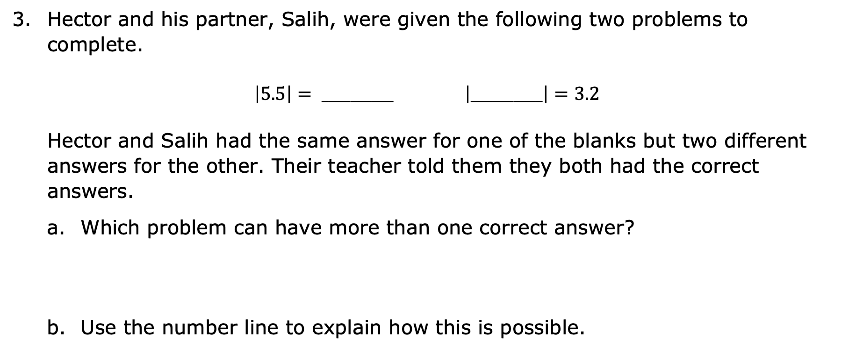
Hector and his partner, Salih, were given the following two problems to complete.
$\left|5.5\right|= __________$ $\left|__________\right|=3.2$
Hector and Salih had the same answer for one of the blanks but two different answers for the other. Their teacher told them they both had the correct answers.
Which problem can have more than one correct answer?
Use the number line to explain how this is possible.
volume 1, pg. 177

Slide 16

Your Turn
volume 1, pg. 177

Slide 17

4.8.5 Your Turn!
Complete each statement and model it on the number line given.
$\left|−7.8\right|$ = _______
$\left|6.25\right|$ = _______
$\left|______\right|$ = $3\frac{1}{2}$
volume 1, pg. 177

Slide 18

Choose any rational number between $−10$ and $10$.
Plot the number and then plot its opposite on the number line.
What is the relationship between the absolute values of these rational numbers?
volume 1, pg. 178

Slide 19

Wrap-Up
volume 1, pg. 178

Slide 20
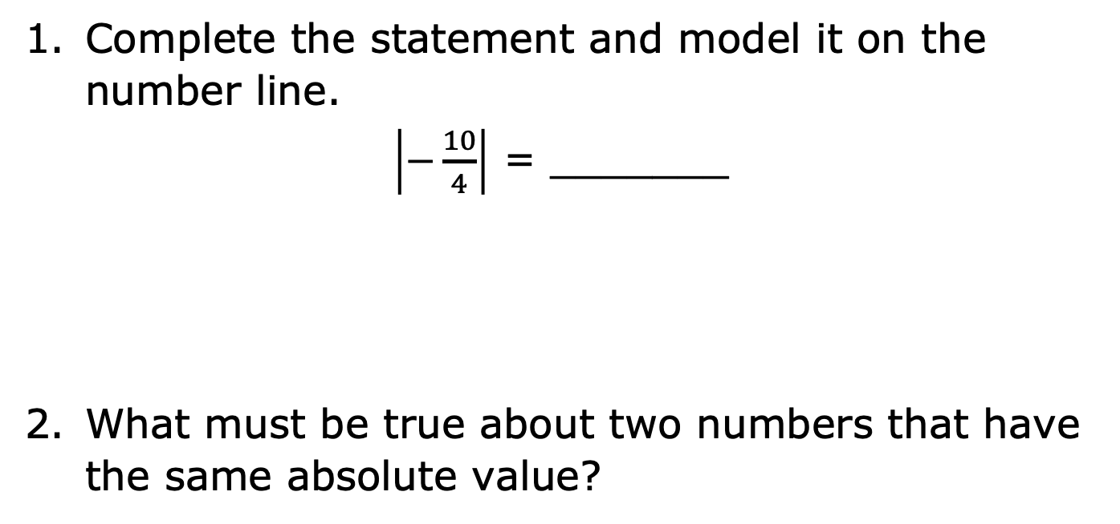
4.8.6 Wrap-Up: Ticket Out the Door
Complete the statement and model it on the number line.
$\left|−\frac{10}{4}\right|$ = _______
What must be true about two numbers that have the same absolute value?
volume 1, pg. 178

